Slide 1


Chronological Age Estimation from DNA methylation data
- a case study in regularized linear regression
Leiden University, Honours Class Data Science
Orsolya Pipek | 4 April 2022

Slide 2




A short overview
CHRONOLOGICAL AGE VS. BIOLOGICAL AGE
DNA METHYLATION
LINEAR REGRESSION WITH REGULARIZATION
CHRONOLOGICAL AGE PREDICTION

Slide 3
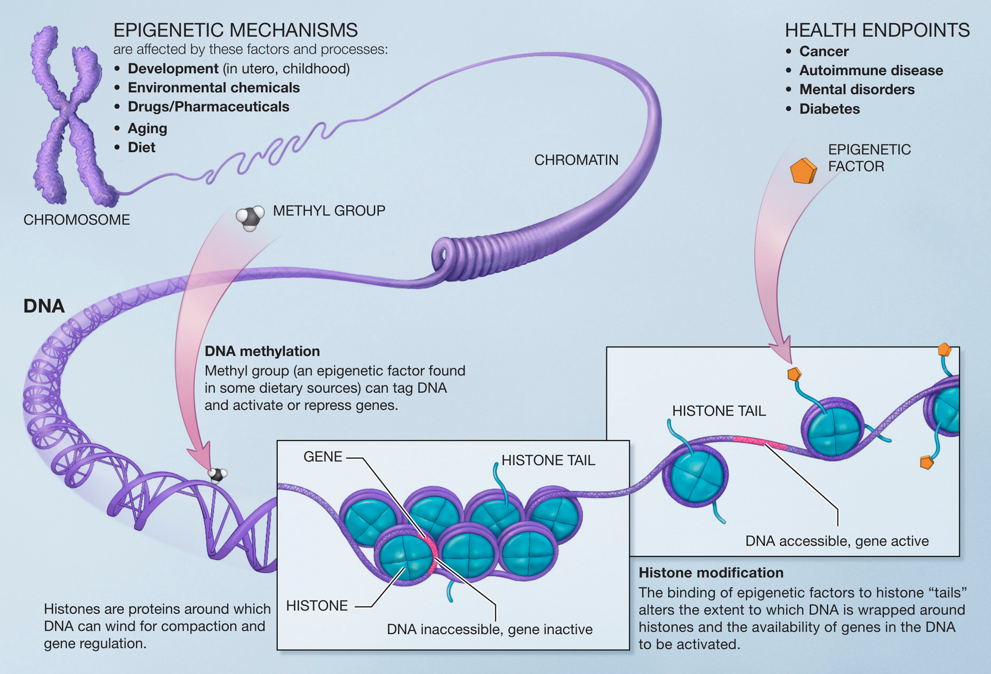
Chronological/biological age
Chronological age: time elapsed since birth
Biological age: captures the different rate of functional deterioration across individuals
Aging has many manifestations (greying hair, wrinkles, reduced mobility, etc.)
Many manifestations are epigenetic (e.g. DNA methylation)
Epigenetic changes: changes functionally effecting the genome that do not involve a change in the nucleotide sequence of the DNA
NIH – National Institutes of Health

Slide 4
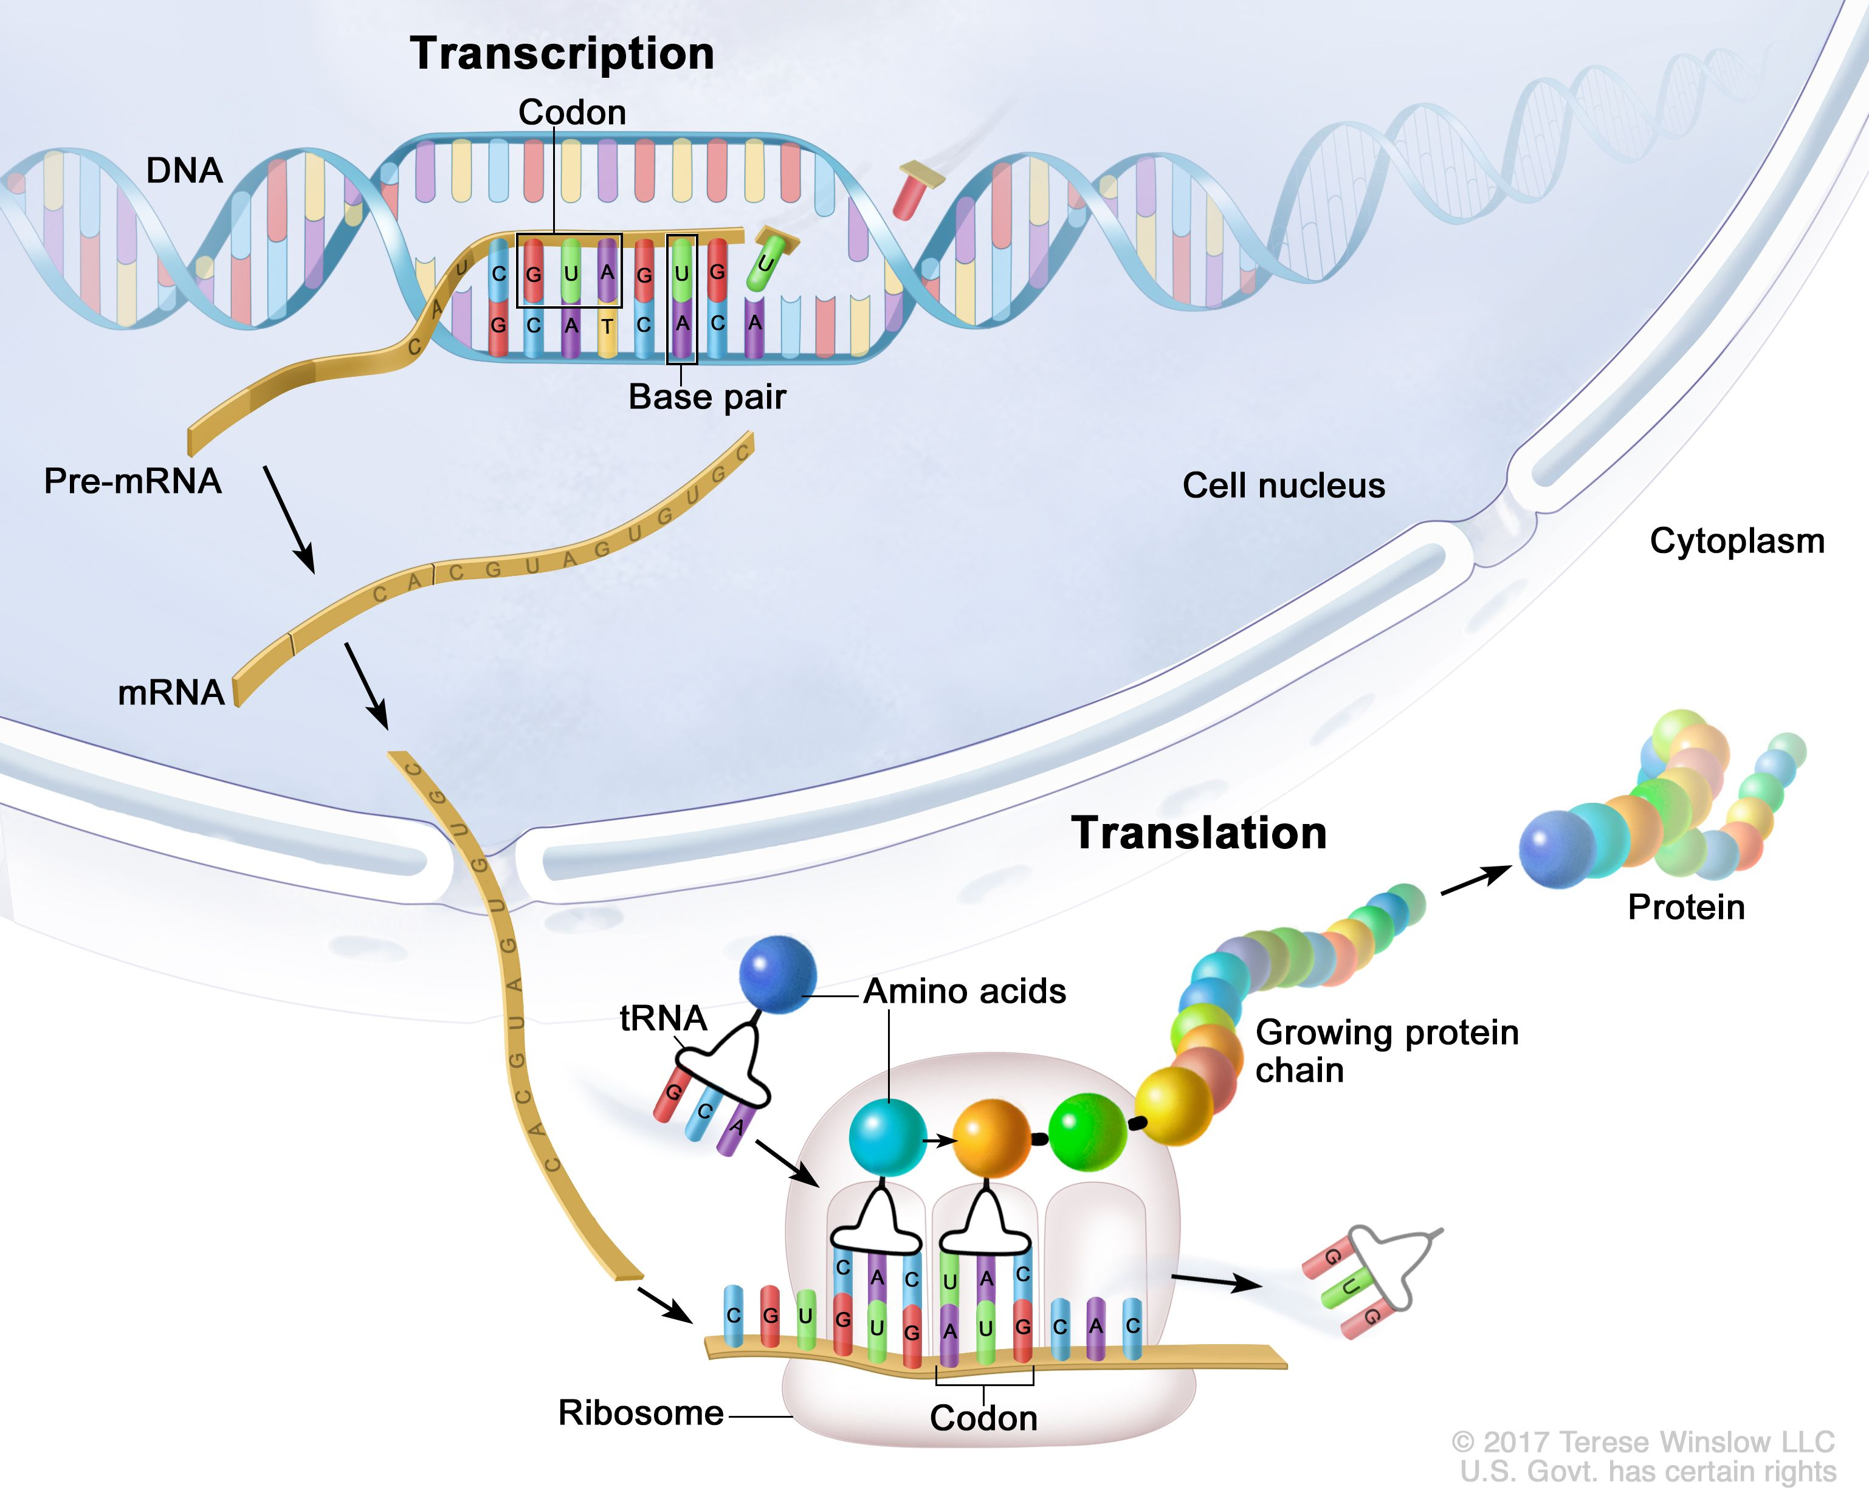
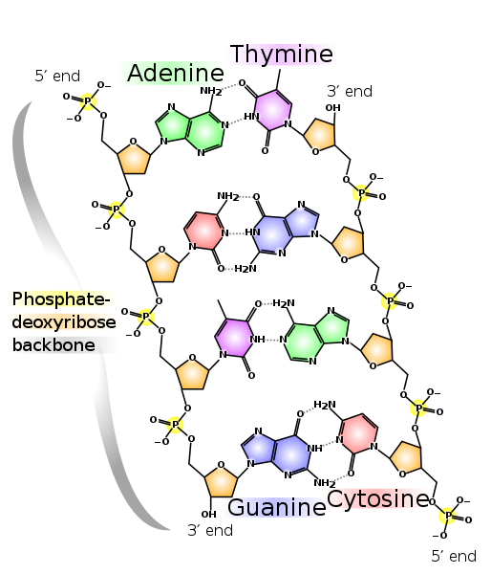
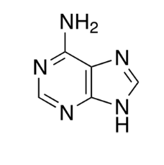
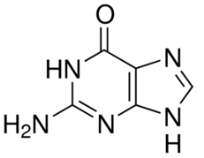

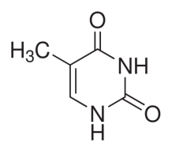
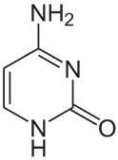
The importance of DNA
adenine
guanine
thymine
cytosine
nucleobases
base-pairs,
double-stranded helix structure
transcription,
translation,
proteins

Slide 5
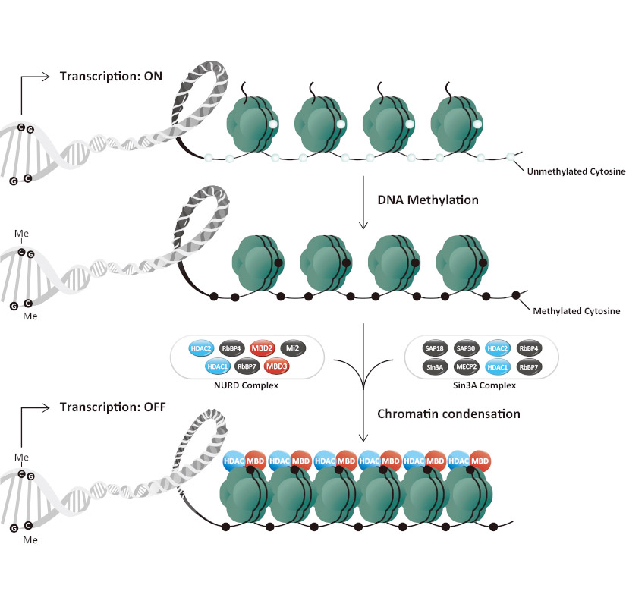
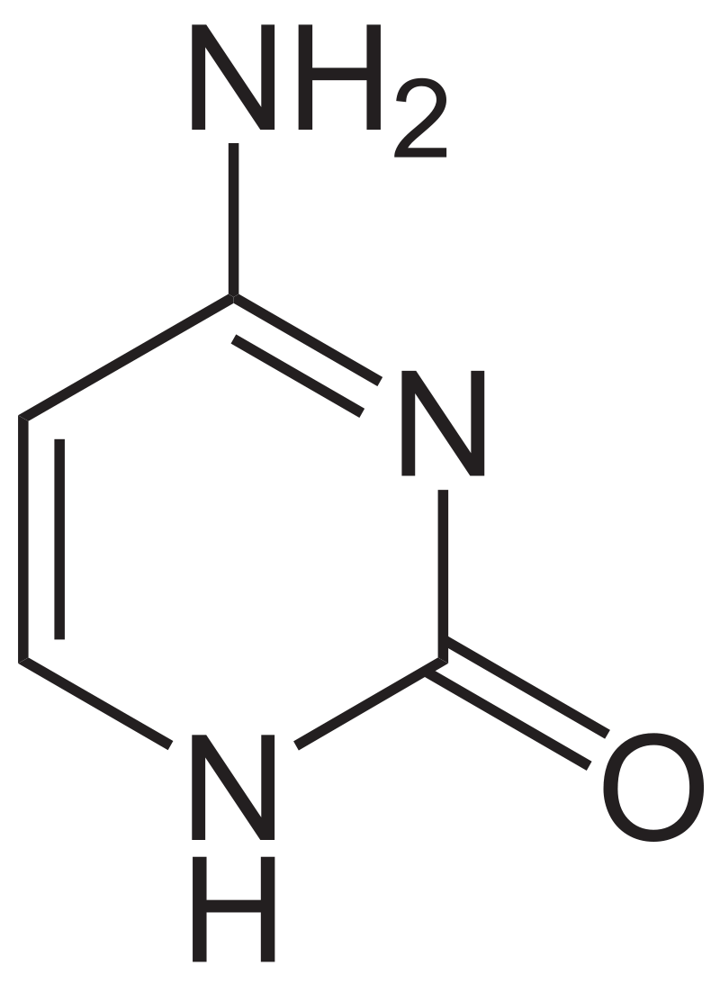
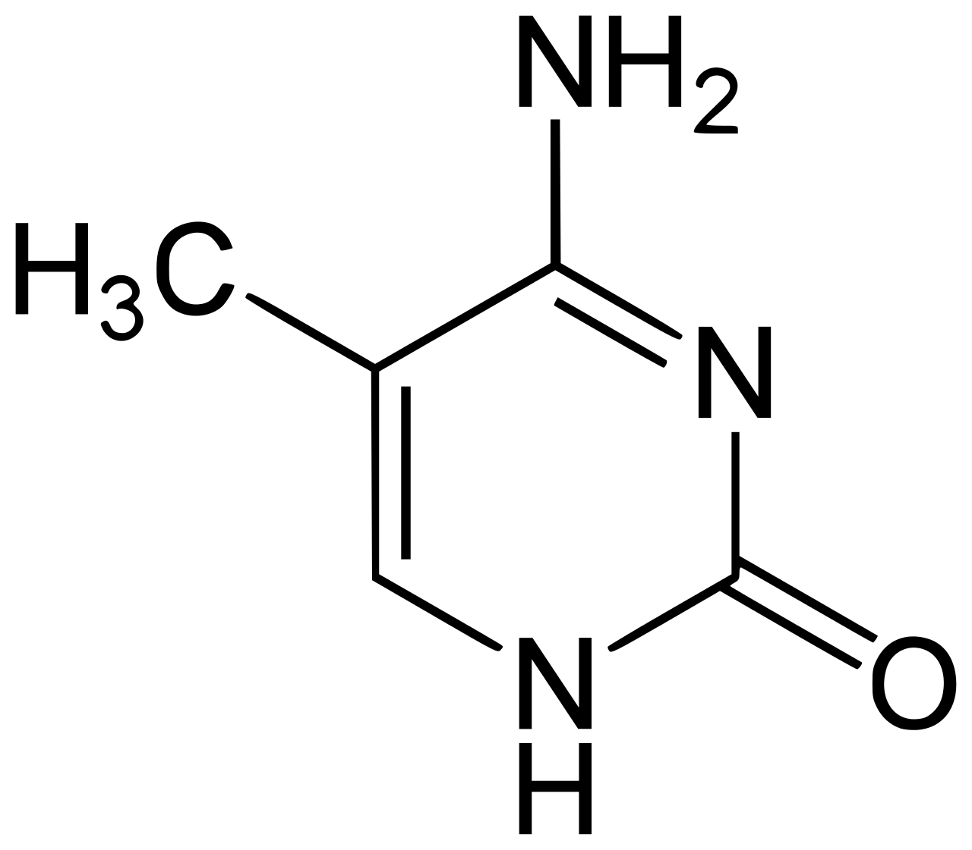

Dna methylation (DNAm)
cytosine
5-methylcytosine
(almost exclusively in CpG dinucleotides)
DNA methylation has a regulatory role by affecting the accessibility of different genomic regions, thus influencing transcription (~ activity)
https://www.genetex.com/Research/Overview/epigenetics/dna_methylation

Slide 6
Dna methylation (DNAm)
cytosine
5-methylcytosine
(almost exclusively in CpG dinucleotides)
DNA methylation has a regulatory role by affecting the accessibility of different genomic regions, thus influencing transcription (~ activity)
https://www.genetex.com/Research/Overview/epigenetics/dna_methylation
… but generally, it’s much more complex

Slide 7
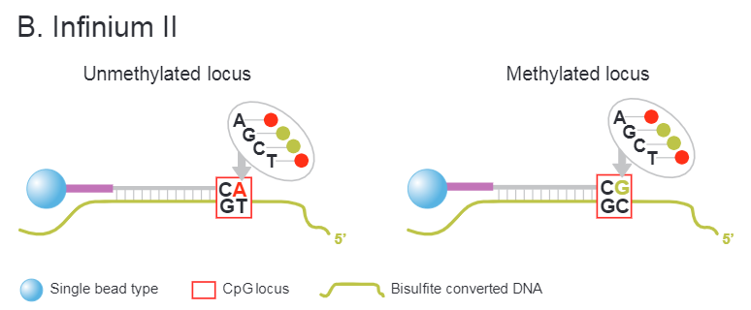
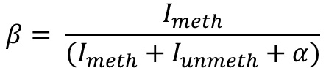
Dna methylation (DNAm)
How is it measured? – a simplified picture
Bisulfite conversion
cytosine → uracil → thymine
methyl-cytosine → cytosine
Amplification
Attachment of single DNA strands to probe sequences terminating right before the target site
Trying to elongate probe sequence with either A/T or G/C nucleotides labelled with different colors
Measuring resulting light intensities
Illumina
$$β= \frac{I_{meth}}{(I_{meth}+I_{unmeth}+α)}$$
→ a single β-value for each
genomic position of interest

Slide 8
Linear regression
~ ”fit a line to the data (sometimes in many-many dimensions) that describes it well enough”

Slide 9
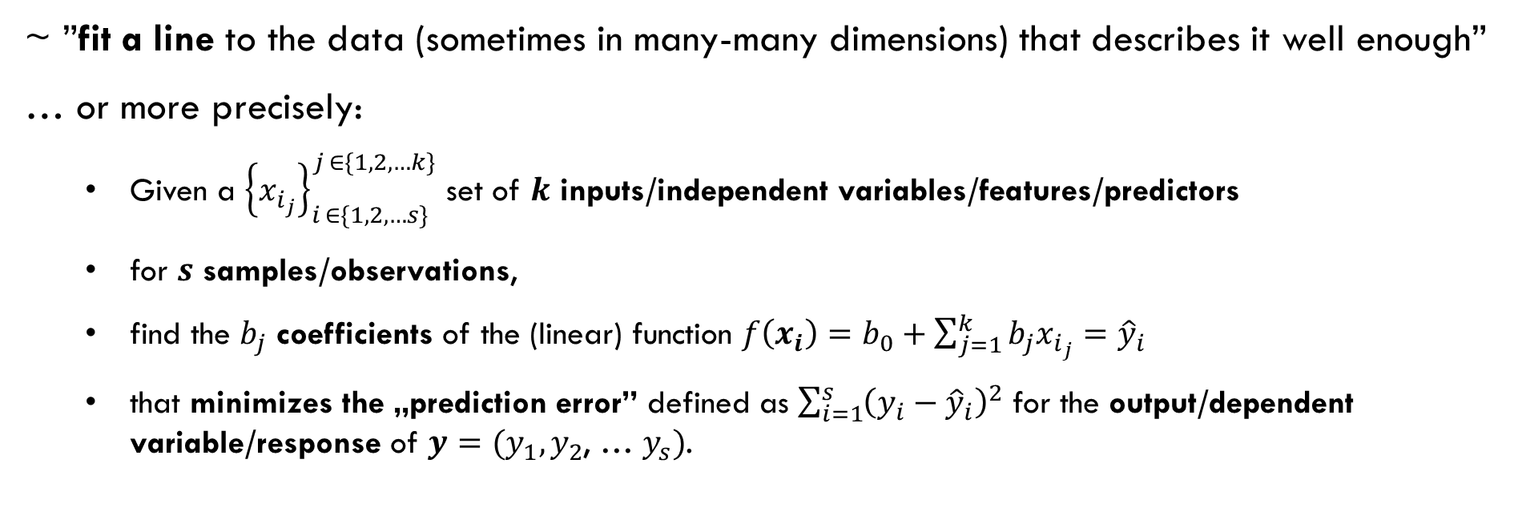
Linear regression
~ ”fit a line to the data (sometimes in many-many dimensions) that describes it well enough”
… or more precisely:
Given a ${\left\{x_{i_{j}}\right\}}_{i ∈\{1, 2, …s\}}^{j ∈\{1, 2, …k\}}$ set of $k$ inputs/independent variables/features/predictors
for $s$ samples/observations,
find the $b_{j}$ coefficients of the (linear) function $f\left(x_{i}\right)=b_{0}+\sum_{j=1}^{k}{b_{j}x_{i_{j}}}={\hat{y}}_{i}$
that minimizes the „prediction error” defined as $\sum_{i=1}^{s}{{\left(y_{i}−{\hat{y}}_{i}\right)}^{2}}$ for the output/dependent variable/response of $y=(y_{1},y_{2}$, … $y_{s})$.

Slide 10
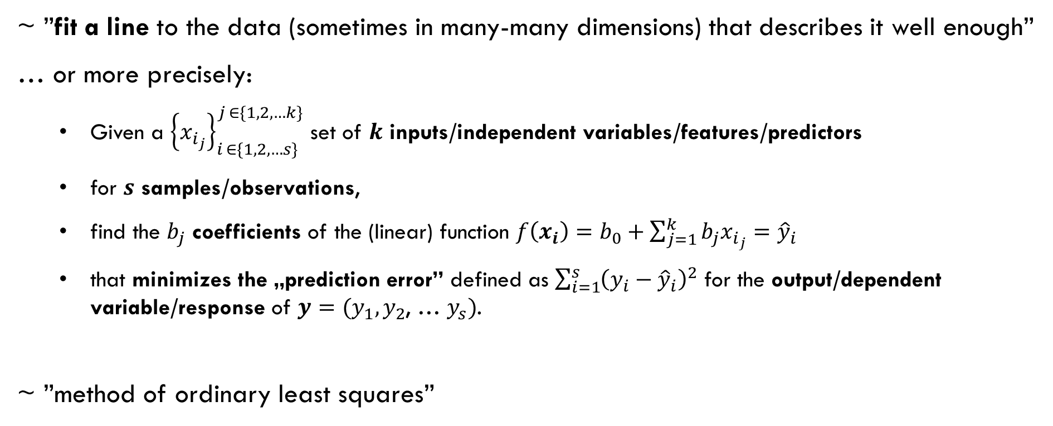
Linear regression
~ ”fit a line to the data (sometimes in many-many dimensions) that describes it well enough”
… or more precisely:
Given a ${\left\{x_{i_{j}}\right\}}_{i ∈\{1, 2, …s\}}^{j ∈\{1, 2, …k\}}$ set of $k$ inputs/independent variables/features/predictors
for $s$ samples/observations,
find the $b_{j}$ coefficients of the (linear) function $f\left(x_{i}\right)=b_{0}+\sum_{j=1}^{k}{b_{j}x_{i_{j}}}={\hat{y}}_{i}$
that minimizes the „prediction error” defined as $\sum_{i=1}^{s}{{\left(y_{i}−{\hat{y}}_{i}\right)}^{2}}$ for the output/dependent variable/response of $y=(y_{1},y_{2}$, … $y_{s})$.
~ ”method of ordinary least squares”

Slide 11
Linear regression – in our case
inputs/independent variables/features/predictors: methylation β-values in targeted genomic positions
samples/observations: patients
output/dependent variable/response: chronological age

Slide 12
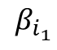
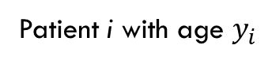
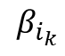
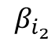
Linear regression – in our case
inputs/independent variables/features/predictors: methylation β-values in targeted genomic positions
samples/observations: patients
output/dependent variable/response: chronological age
$$β_{i_{1}}$$
$$β_{i_{2}}$$
Patient i with age $y_{i}$
…
$$β_{i_{k}}$$

Slide 13

Linear regression – in our case
inputs/independent variables/features/predictors: methylation β-values in targeted genomic positions
samples/observations: patients
output/dependent variable/response: chronological age
$$β_{i_{1}}$$
$$β_{i_{2}}$$
Patient i with age $y_{i}$
…
$$β_{i_{k}}$$

Slide 14

Linear regression – in our case
inputs/independent variables/features/predictors: methylation β-values in targeted genomic positions
samples/observations: patients
output/dependent variable/response: chronological age
$$β_{i_{1}}$$
$$β_{i_{2}}$$
Patient i with age $y_{i}$
…
$$β_{i_{k}}$$

Slide 15
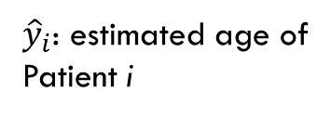
Linear regression – in our case
inputs/independent variables/features/predictors: methylation β-values in targeted genomic positions
samples/observations: patients
output/dependent variable/response: chronological age
$$β_{i_{1}}$$
$$β_{i_{2}}$$
Patient i with age $y_{i}$
${\hat{y}}_{i}$: estimated age of
Patient i
…
$$β_{i_{k}}$$

Slide 16

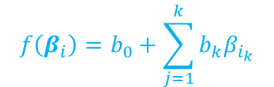
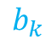
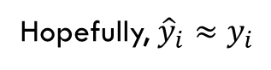
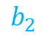
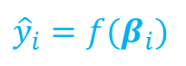
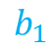

Linear regression – in our case
inputs/independent variables/features/predictors: methylation β-values in targeted genomic positions
samples/observations: patients
output/dependent variable/response: chronological age
$$b_{0}$$
$$β_{i_{1}}$$
$$f\left(β_{i}\right)=b_{0}+\sum_{j=1}^{k}{{b_{k}β}_{i_{k}}}$$
$$b_{1}$$
$$β_{i_{2}}$$
$$b_{2}$$
Patient i with age $y_{i}$
${\hat{y}}_{i}$: estimated age of
Patient i
…
$$b_{k}$$
$$β_{i_{k}}$$
Linear regression
$${\hat{y}}_{i}=f(β_{i})$$
Hopefully, ${\hat{y}}_{i}≈y_{i}$

Slide 17
Linear regression – in our case
inputs/independent variables/features/predictors: methylation β-values in targeted genomic positions
samples/observations: patients
output/dependent variable/response: chronological age
Is the model bad if a patient’s predicted age is vastly different from his/her chronological age?
What could cause such an effect besides a bad model?
$$b_{0}$$
$$β_{i_{1}}$$
$$f\left(β_{i}\right)=b_{0}+\sum_{j=1}^{k}{{b_{k}β}_{i_{k}}}$$
$$b_{1}$$
$$β_{i_{2}}$$
$$b_{2}$$
Patient i with age $y_{i}$
${\hat{y}}_{i}$: estimated age of
Patient i
…
$$b_{k}$$
$$β_{i_{k}}$$
Linear regression
$${\hat{y}}_{i}=f(β_{i})$$
Hopefully, ${\hat{y}}_{i}≈y_{i}$

Slide 18
Linear regression – avoiding overfitting
Number of features: 27K / 450K / 850K (depending on measurement platform)
Number of patients: 10K at best (depending on data availability and research funds)
There is an enormous chance of overfitting the model if we use all β-values for prediction!

Slide 19
Linear regression – avoiding overfitting
Number of features: 27K / 450K / 850K (depending on measurement platform)
Number of patients: 10K at best (depending on data availability and research funds)
There is an enormous chance of overfitting the model if we use all β-values for prediction!
→ REGULARIZATION!

Slide 20
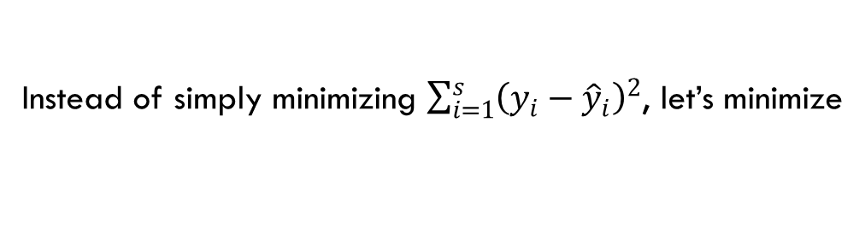

Linear regression – avoiding overfitting
Number of features: 27K / 450K / 850K (depending on measurement platform)
Number of patients: 10K at best (depending on data availability and research funds)
There is an enormous chance of overfitting the model if we use all β-values for prediction!
→ REGULARIZATION! ~ punishing the use of many large coefficients
Instead of simply minimizing $\sum_{i=1}^{s}{{\left(y_{i}−{\hat{y}}_{i}\right)}^{2}}$, let’s minimize
$$\sum_{i=1}^{s}{{\left(y_{i}−{\hat{y}}_{i}\right)}^{2}}+α\sum_{j=1}^{k}{b_{j}^{2}+λ\sum_{j=1}^{k}{\left|b_{j}\right|}}$$

Slide 21
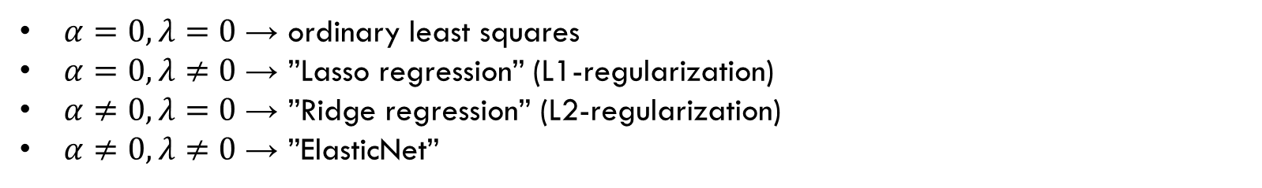
Linear regression – avoiding overfitting
Number of features: 27K / 450K / 850K (depending on measurement platform)
Number of patients: 10K at best (depending on data availability and research funds)
There is an enormous chance of overfitting the model if we use all β-values for prediction!
→ REGULARIZATION! ~ punishing the use of many large coefficients
Instead of simply minimizing $\sum_{i=1}^{s}{{\left(y_{i}−{\hat{y}}_{i}\right)}^{2}}$, let’s minimize
$$\sum_{i=1}^{s}{{\left(y_{i}−{\hat{y}}_{i}\right)}^{2}}+α\sum_{j=1}^{k}{b_{j}^{2}+λ\sum_{j=1}^{k}{\left|b_{j}\right|}}$$
$α=0, λ=0$ → ordinary least squares
$α=0, λ≠0$ → ”Lasso regression” (L1-regularization)
$α≠0, λ=0$ → ”Ridge regression” (L2-regularization)
$α≠0, λ≠0$ → ”ElasticNet”

Slide 22
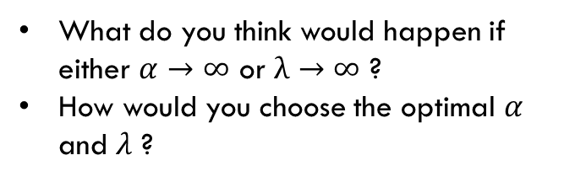
Linear regression – avoiding overfitting
Number of features: 27K / 450K / 850K (depending on measurement platform)
Number of patients: 10K at best (depending on data availability and research funds)
There is an enormous chance of overfitting the model if we use all β-values for prediction!
→ REGULARIZATION! ~ punishing the use of many large coefficients
Instead of simply minimizing $\sum_{i=1}^{s}{{\left(y_{i}−{\hat{y}}_{i}\right)}^{2}}$, let’s minimize
$$\sum_{i=1}^{s}{{\left(y_{i}−{\hat{y}}_{i}\right)}^{2}}+α\sum_{j=1}^{k}{b_{j}^{2}+λ\sum_{j=1}^{k}{\left|b_{j}\right|}}$$
What do you think would happen if either $α→∞$ or $λ→∞$ ?
How would you choose the optimal $α$ and $λ$ ?
$α=0, λ=0$ → ordinary least squares
$α=0, λ≠0$ → ”Lasso regression” (L1-regularization)
$α≠0, λ=0$ → ”Ridge regression” (L2-regularization)
$α≠0, λ≠0$ → ”ElasticNet”

Slide 23
Constructing the ”epigenetic clock”
For details, check out Horvath (2013): DNA methylation age of human tissues and cell types

Slide 24
Constructing the ”epigenetic clock”
For details, check out Horvath (2013): DNA methylation age of human tissues and cell types
Training & test data:
Publicly available
From healthy donors
The data from a specific study was never split between train & test sets
Two different measurement platforms (27K & 450K Illumina beadchip)
Many different tissues

Slide 25

Constructing the ”epigenetic clock”
For details, check out Horvath (2013): DNA methylation age of human tissues and cell types
Training & test data:
Publicly available
From healthy donors
The data from a specific study was never split between train & test sets
Two different measurement platforms (27K & 450K Illumina beadchip)
Many different tissues
Why?

Slide 26
Constructing the ”epigenetic clock”
For details, check out Horvath (2013): DNA methylation age of human tissues and cell types
Training & test data:
Publicly available
From healthy donors
The data from a specific study was never split between train & test sets
Two different measurement platforms (27K & 450K Illumina beadchip)
Many different tissues
Why?

Slide 27
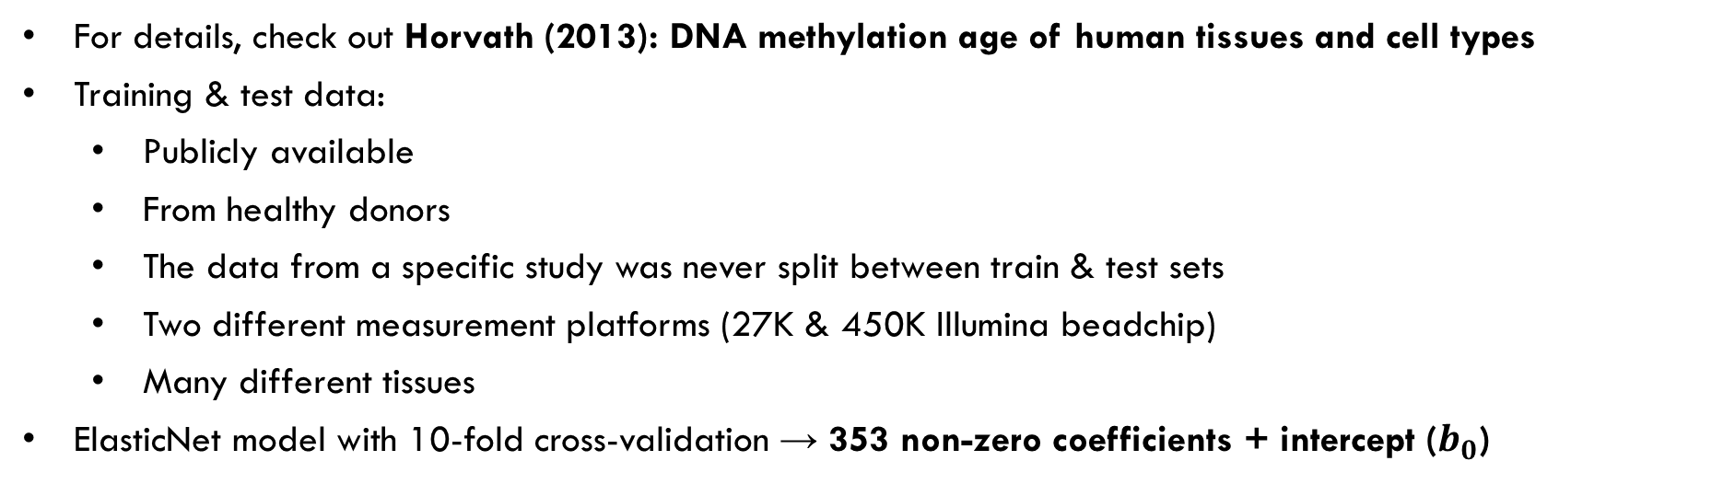
Constructing the ”epigenetic clock”
For details, check out Horvath (2013): DNA methylation age of human tissues and cell types
Training & test data:
Publicly available
From healthy donors
The data from a specific study was never split between train & test sets
Two different measurement platforms (27K & 450K Illumina beadchip)
Many different tissues
ElasticNet model with 10-fold cross-validation → 353 non-zero coefficients + intercept ($b_{0}$)

Slide 28
Constructing the ”epigenetic clock”
For details, check out Horvath (2013): DNA methylation age of human tissues and cell types
Training & test data:
Publicly available
From healthy donors
The data from a specific study was never split between train & test sets
Two different measurement platforms (27K & 450K Illumina beadchip)
Many different tissues
ElasticNet model with 10-fold cross-validation → 353 non-zero coefficients + intercept ($b_{0}$)
What’s that?

Slide 29
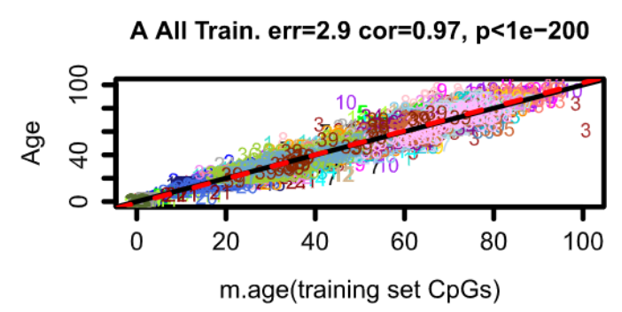
Constructing the ”epigenetic clock”
Results:
Fig 1A.

Slide 30
Constructing the ”epigenetic clock”
Results:
on all training data
Fig 1A.

Slide 31
Constructing the ”epigenetic clock”
Results:
on all training data
Fig 1A.
chronological age in years

Slide 32
Constructing the ”epigenetic clock”
Results:
on all training data
Fig 1A.
chronological age in years
estimated ”DNAm age” in years

Slide 33
Constructing the ”epigenetic clock”
Results:
on all training data
Fig 1A.
chronological age in years
estimated ”DNAm age” in years
different colours indicate different data sources

Slide 34
Constructing the ”epigenetic clock”
Results:
on all training data
Fig 1A.
median absolute error in years: for half of the patients in the training set, the difference between the estimated and the actual age was smaller than 2.9 years
chronological age in years
estimated ”DNAm age” in years
different colours indicate different data sources

Slide 35
Constructing the ”epigenetic clock”
Results:
on all training data
Fig 1A.
median absolute error in years
Pearson-correlation between actual and predicted age
chronological age in years
estimated ”DNAm age” in years
different colours indicate different data sources

Slide 36
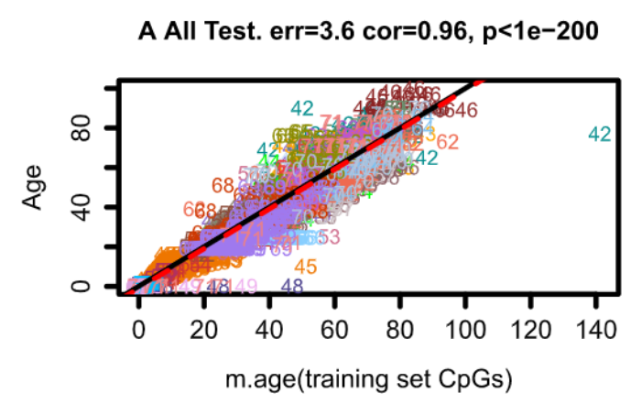
Constructing the ”epigenetic clock”
Results:
Fig 1A.
on all training data
Fig 2A.
on all test data
On which dataset would you expect higher correlation? Why?
On which dataset would you expect higher median absolute error? Why?

Slide 37



Trying it out for real…
Downloading an appropriate dataset
Building a model that predicts age
Testing the Horvath multi-tissue epigenetic clock
Comparing the results

